Slide 1

Decision tree & Neural network for mobile Phone data
2024 Data Science Tech Excellence Capstone Project
Christian craft
Ben Mathews
Lucas miller
Brett Padgett
Tim remo
February 15, 2024
Notes:
Tim
Good morning everyone! Thank you for being here.
My name is Tim and I have the pleasure of introducing our project and our team.
Today, we are excited to present our project on Decision Tree & Neural Network for Mobile Phone Data. In this presentation, we will discuss how we utilized these powerful machine learning techniques to analyze and derive insights from mobile phone data.
We put a lot of work into this and we hope it shows. In addition to our evaluation, our aim is for you to walk away having learned something.
Now let's meet the team.

Slide 2










Tim Remo
Data Science Consultant
B.S. Elementary Education; University of Maryland College Park , 2010
Ben Mathews
Data Science Consultant
B.S. Computational Modeling and Data Analytics; Virginia Tech, 2023
Christian Craft
Data Science Consultant
B.S. Computer Science; Missouri University of Science & Technology, 2023
Brett Padgett
Data Science Consultant
B.S.B.A. Enterprise Cybersecurity;
Old Dominion University, 2023
Lucas Miller
General Management Consultant
B.A. Political Science; James Madison University, 2023
Notes:
All

Slide 3
Problem Statement
Design and implement machine learning to predict prices of mobile-phones
Methodology: Decision Tree and Neural Network
Notes:
Tim
The goal of this experiment is to design and implement a machine learning model to classify mobile phones into price ranges based on specifications such as RAM, battery power, touchscreen capabilities, and other relevant features.
The methodology for classification that we decided on was Decision Tree and Neural Network

Slide 4



Dataset
Mobile Phone Prices
21 features, 2000 rows
Split into train and test
Train is labeled, test is not
Find the price of the unlabeled phones
Dataset Context
Owner of a mobile phone company
Needs to know how to estimate phone prices, To solve this problem, he collects sales data of mobile phones of various companies.
Bob wants to find out some relation between features of a mobile phone( RAM, Internal Memory, etc.) and its selling price
Notes:
Ben
The dataset we chose to analyze is a collection of 21 features that phones can have and it contains 2000 rows of samples with no missing values, so it was easy to use and helped us produce some pretty useful output. It was also split into a labeled training set and a test set, but since the test set didn’t contain price data we ended up only using the training set.
The context of the dataset is imaging an owner of a mobile phone company needs to know how to estimate phone prices, and they do this by collecting sales data from other mobile phone companies, and some of the data points he collects include how much ram, memory, and battery life as well as other values different phone have.

Slide 5



Early Assumptions
Phone Selling Points
Battery Life
Screen size/resolution
Processor/RAM
CPU cores
Common Features
Touch Screen
3G/4G
Wi-fi/Bluetooth
Dual Sim Tray
Notes:
Brett- Early assumptions about the data. Based upon what we know from phones, we know that they sell differently based upon different features. These feature variables include battery life, screen size, and its processing capabilities. There are also common features that are built into our phones today, which include a touch screen, 3G and 4G, wifi, bluetooth, and a Dual sim tray. From these assumptions we can have an idea what the data may look like.

Slide 6
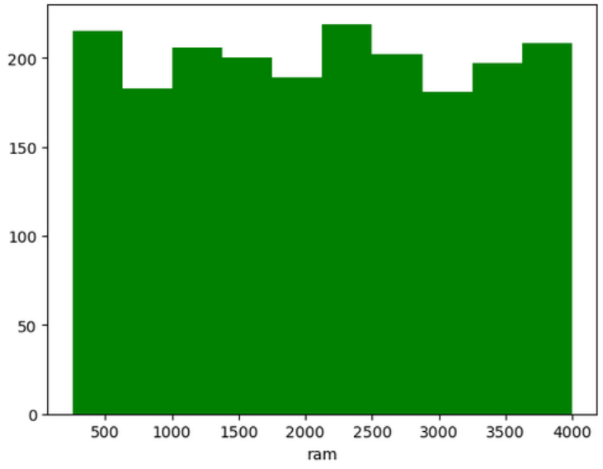
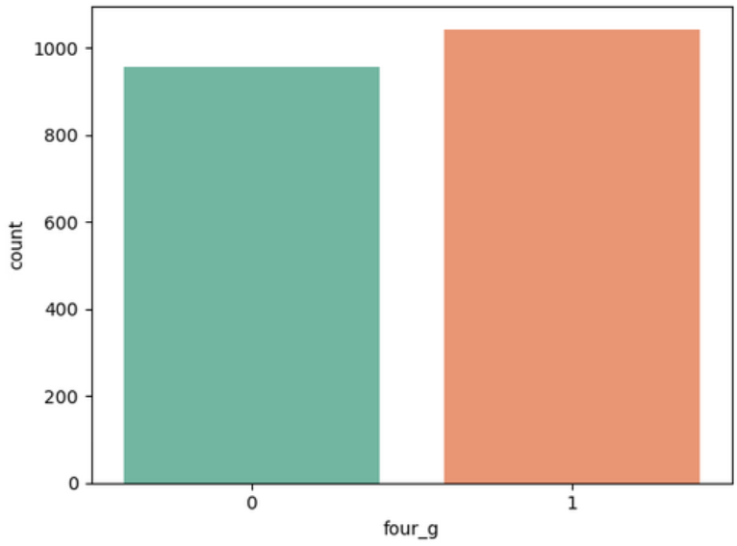
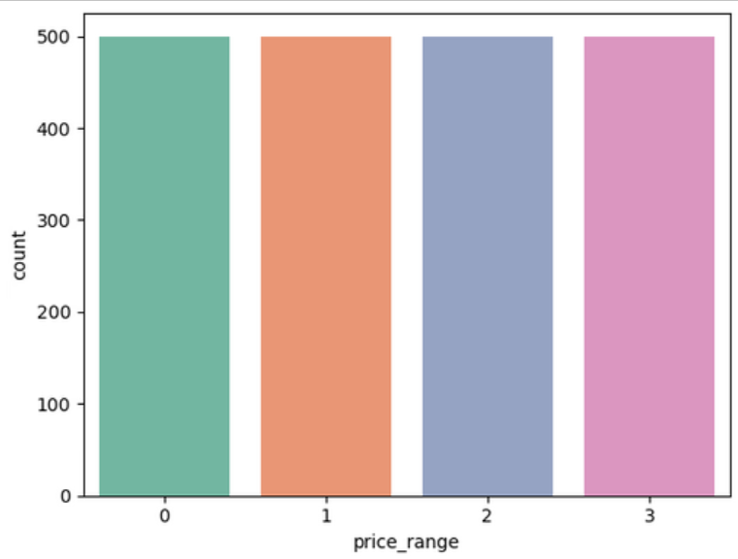
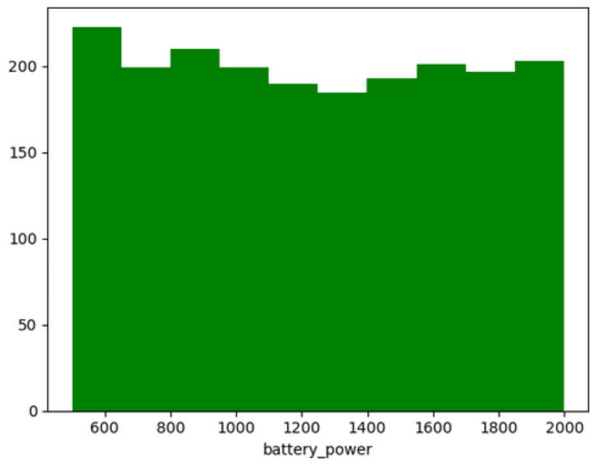
Visualizations
Very clean, evenly distributed dataset
No missing values
Balanced across all variables
Versatile
Immediately useable
Ram 4G Network
Count Count
Count Count
Price Range Battery Life
Notes:
Lucas evenly distributed

Slide 7
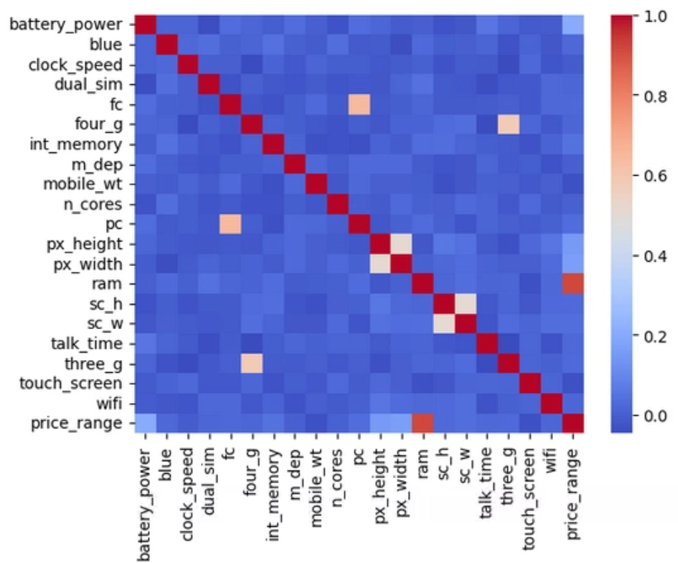
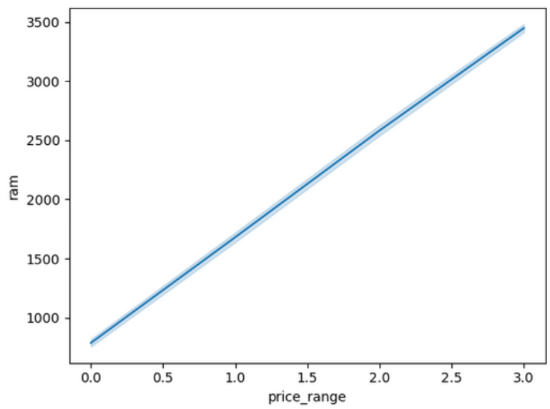
Predictor Variable
Correlation Matrix for all variables RAM in MB Vs. Price Range of Device
Notes:
Christian

Slide 8
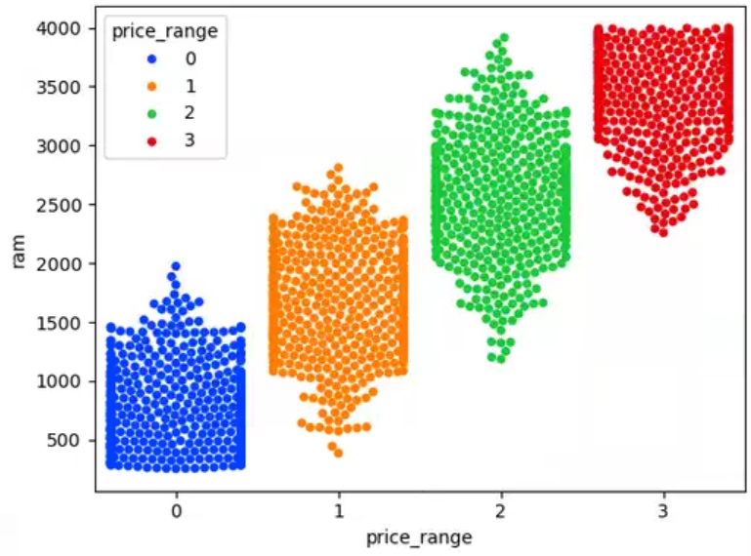
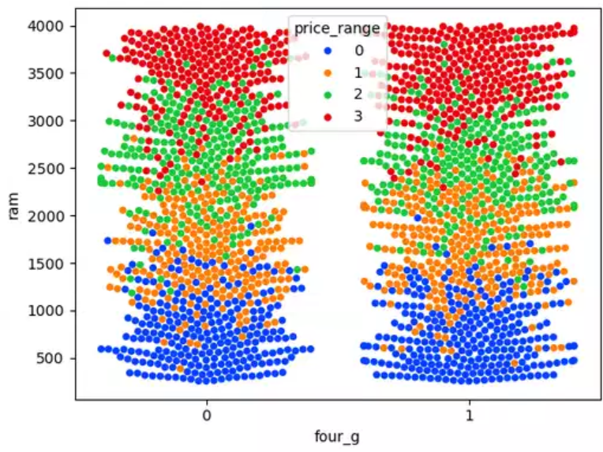
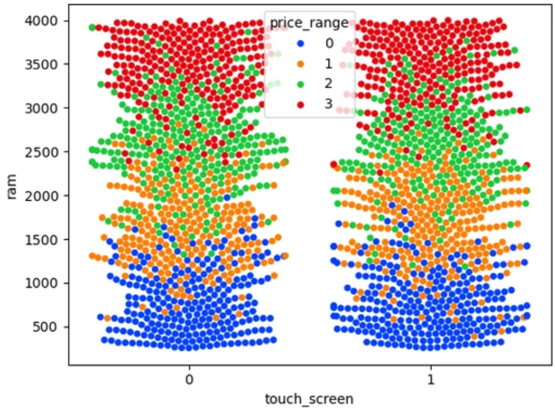
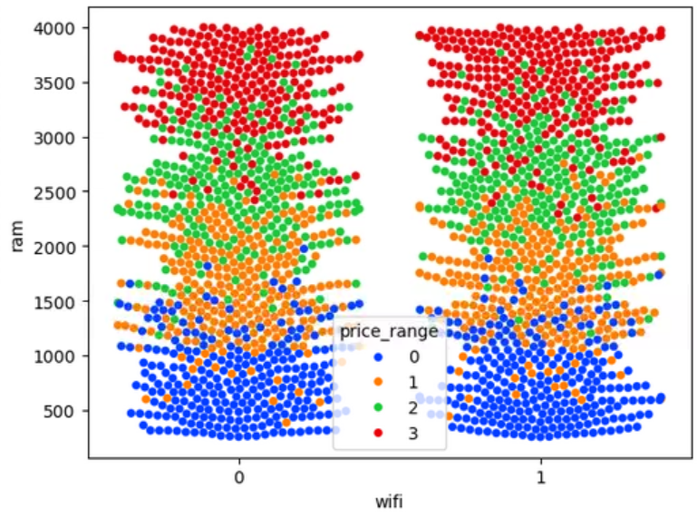
Exploratory Data Analysis
Testing secondary effects via Swarm Plot
Minimal effect
Touch Screen
Dual Sim
3G/4G
Bluetooth
Wi-Fi
Price vs. RAM has considerable overlap
Notes:
Christian

Slide 9

What is a Decision Tree?
Supervised ML algorithm used for classification or regression
Classifiers are used to utilize training data to develop a flow chart leading to a series of categories, based on certain conditions
Analyzes features to map an input to the corresponding output
The quality of the tree is measured by applying it to the testing data
We can learn what events lead to a resulting target value
Notes:
Lucas
Why did we choose to use These models
Handle nonlinearity very well

Slide 10
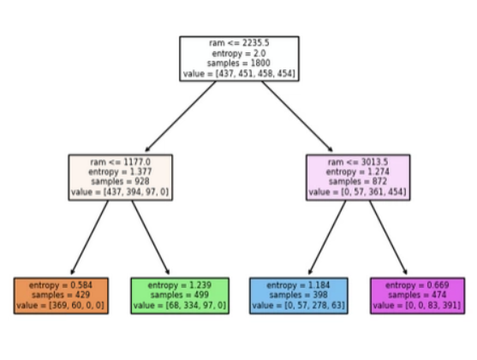
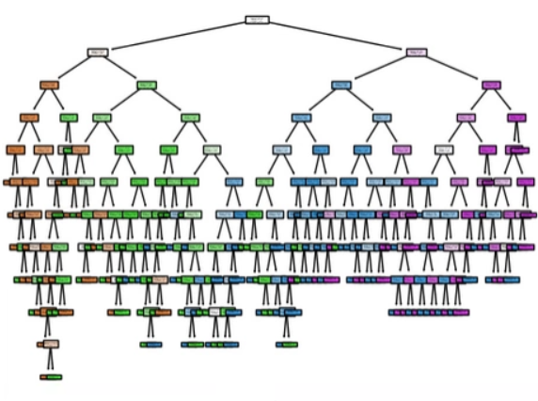
Decision Tree Output
Full Tree Graph
Condensed Tree Graph
Notes:
Brett- This is the output produced from the classification model by plotting a tree graph. For visualization purposes, the graph on the right is just is just a condensed portion from the full tree on the left.
The decision tree selects the feature variables that are most useful in explaining the price with each leaf labeled with its most probable class. From there, we can try to learn what events might have led to the resulting price.

Slide 11
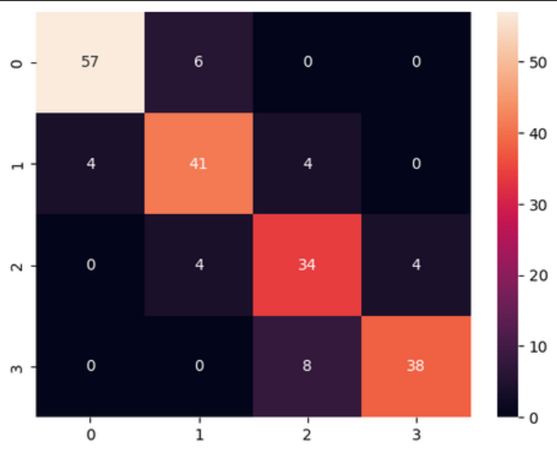
Decision Tree Output
Using a decision tree on the test data set yielded this confusion matrix
14 False Positives
16 False Negatives
170 Accurate predictions
85% overall accuracy
Confusion Matrix of Decision Tree predictions
Notes:
Christian

Slide 12

What are Neural Networks?
Unsupervised Learning
Simulates learning in the way humans learn
Through training on data, neural networks can learn patterns and relationships
Useful for tasks like image recognition, natural language processing, and more
Notes:
Tim
Neural networks are algorithms inspired by the human brain, designed to recognize patterns in data. They consist of interconnected nodes (neurons) that learn from input data to make decisions or predictions.
We chose to create a neural network for classification because of its ability to:
Learn complex patterns
Automatically extract relevant features
Handle large data sets

Slide 13

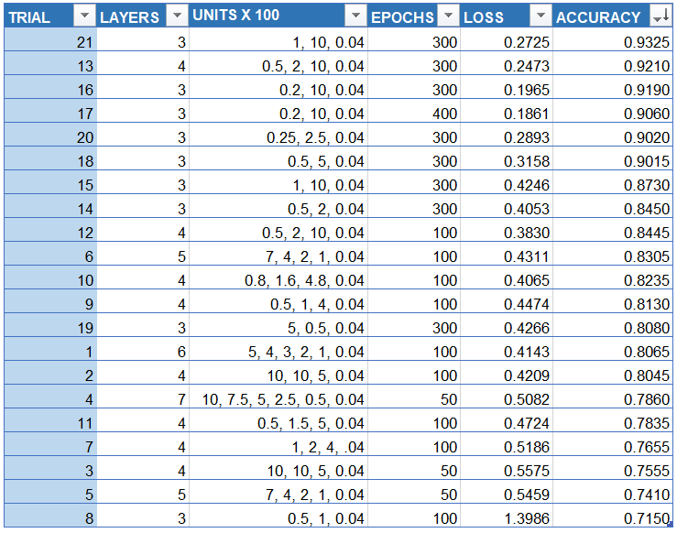
Neural Network Output
Notes:
Tim
Here we have a table of multiple trials that we ran with different numbers of layers, layers depths, and number of epochs, and we sorted it in order of the highest accuracy. We found a trend of having a lower number of layers produced lower loss values on average, and higher accuracy. We also found that the more epochs we used produced a higher accuracy which makes sense since it has more repetitions to run the network and learn from the previous attempts.

Slide 14
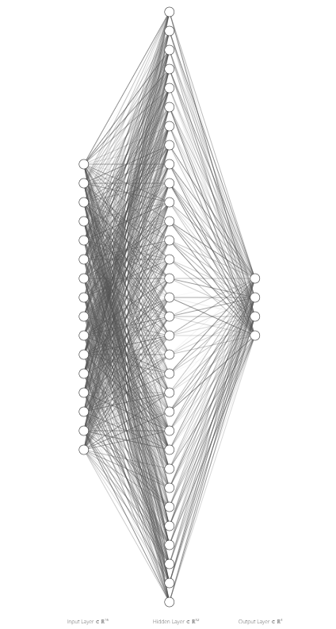
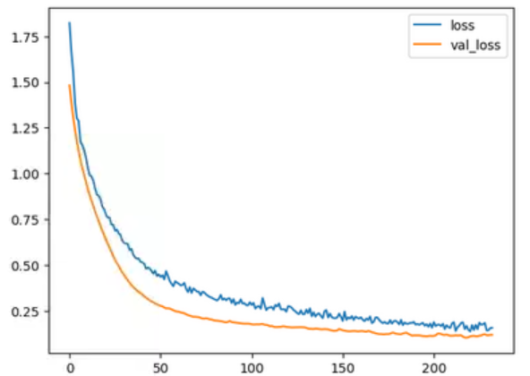
Wider, Shallow NN
32, 64, 4
Benefits diverse data
Notes:
Ben
After experimenting with different numbers of layers and the number of units per layer, we found that having a wider and shallower model benefitted the output for our data. In this graph we can see that the validated loss and the actual loss from our model followed a similar trend, and started to converge at the end here.
We also implemented early stopping which helped end the number of epochs we used early when the loss started to even out with the hope that it will prevent overfitting.

Slide 15
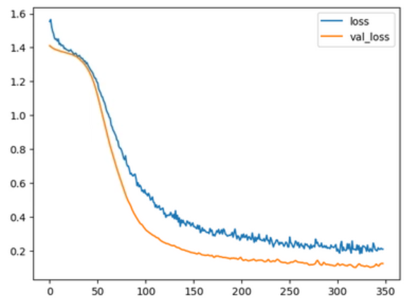
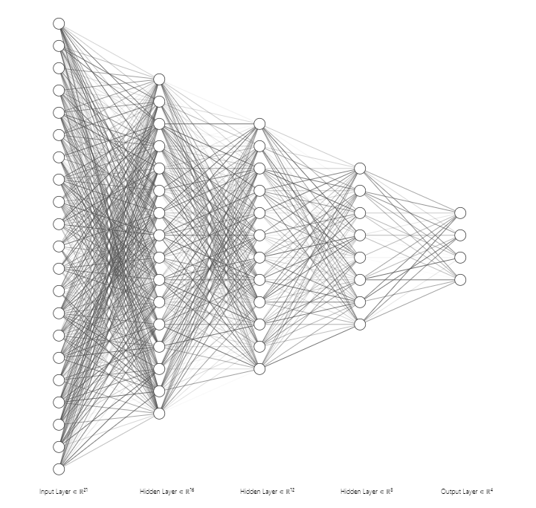
Deeper/Longer NN
34, 16, 12, 8, 4
Prone to more overfitting
Notes:
Ben
An example of a deeper network that we started with is shown here where we had 5 layers with less units each, and from this graph we can see that the loss didn’t converge to the validated loss as much as the last model and it also ran an additional 100 epochs before it hit an early stopping point.
From this we concluded that for our dataset a shallower network produced a more desirable output.

Slide 16
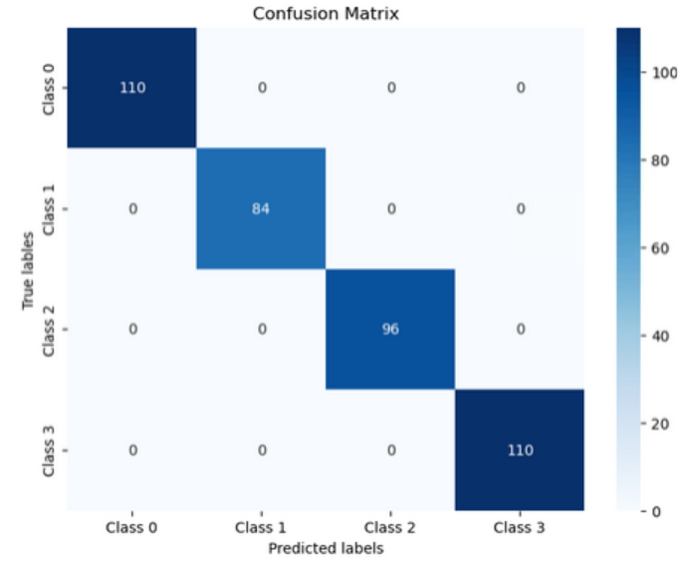
Neural Network Output
Confusion Matrix produced from the Neural Network test data.
Depicts 100% accuracy
Notes:
Ben
When we produced our confusion matrix we found that it produced a 100% accurate prediction with no false positives or negatives, and we believe this may be due to a combination of overfitting and a lot of the data having a very close linear trend, so it is easy for our model to reach very high levels of accuracy

Slide 17

Conclusion
Both approaches indicate a strong relationship between Price and RAM
RAM is expensive
Other features have much less impact

Slide 18

What Problem are we solving with our findings?
Useful for new price recommendations
Can be implemented as a simple pricing tool
This approach can be applied to a variety of other products
Price products in an unfamiliar field
Cross reference prices to see deviation from market trends

Slide 19
Sources
Keras API - https://keras.io/api/
Scikit-Learn API - https://scikit-learn.org/stable/modules/classes.html

